Slide 1
UE21CS461A – Project Phase – 3
CAPSTONE MELA - 2025
Project Title : Indexing and Summarization of Sports
Videos using Multi-Modal Approach
Project ID : 61
Project Guide : Dr. Sandesh B J
Project Team : PES2UG21CS242 (Krupashree M V)
PES2UG21CS289 (Meenal Bagare)
PES2UG21CS294 (Melvin Jojee Joseph)
PES2UG21CS324 (Naveen Kumar Reddy G)

Slide 2
Problem Statement
In today's fast-paced world, sports enthusiasts often struggle to find time to watch full-length games. Traditional sports video summarization methods rely on large editing teams to manually review game footage, select key moments, and compile highlights. This process is not only time-consuming and resource-intensive but can also result in uneven coverage of events.
Our project aims to revolutionize the sports summarization process by leveraging a multi-modal approach that integrates:
Twitter Data: Analyzing audience reactions in real-time to identify significant moments.
Audio Features: Detecting audio cues like crowd roars or commentator excitement to pinpoint key events.
Video Content: Processing visual footage to capture and highlight critical moments.

Slide 3
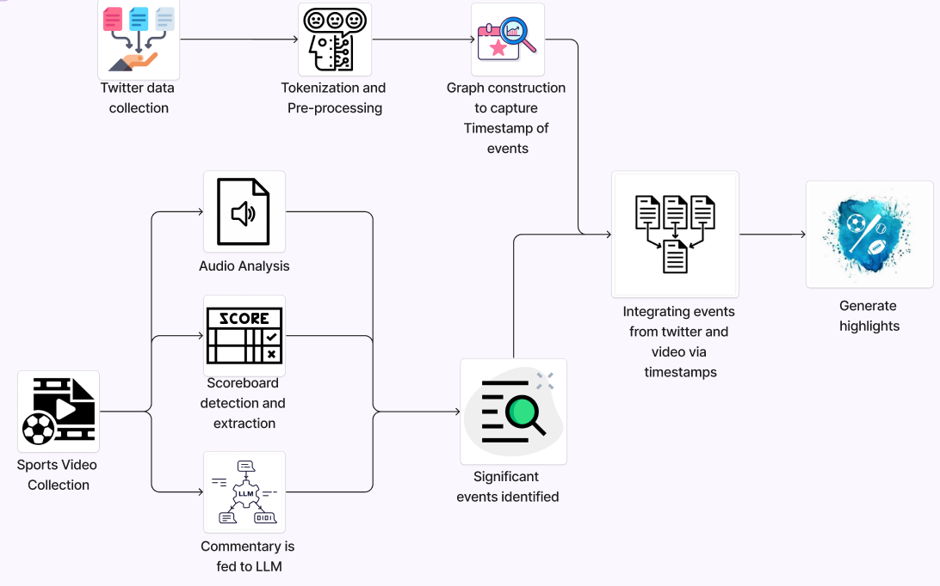
Architecture Diagram

Slide 4

Project Demonstration

Slide 5
Results and Discussion
Multi-modal Results
We have decided to compare our generated summary with popular summaries available on YouTube for that particular match in order to assess our model’s performance.
Match | Events in YouTube Summary | Events in Generated Summary | Relevant Events In Detected Highlights | Precision | Recall (%)
France vs. Croatia | 7 | 10 | 9 | 70% | 90%
Portugal vs. Spain | 8 | 11 | 9 | 72% | 81.8%
Belgium vs. Brazil | 6 | 9 | 7 | 66.6% | 77%

Slide 6
Results and Discussion
Multi-modal Results
Goal Detection in Multi-modal system-The scoreboard detection modality ensured all goals were successfully identified, yielding a 100% Goal Ratio across matches.
Match | Goals Detected by Model | Total Goals | Goal Ratio (%)
France vs. Croatia | 6 | 6 | 100%
Portugal vs. Spain | 5 | 6 | 83.3%
Belgium vs. Brazil | 3 | 3 | 100%

Slide 7
Thank You

